Slide 1

Val Allen Ursua Eltagonde ;)
HELLO,

Slide 2
Contents <33
Secret
1
Maghintay ka
2
Ok
3
hehehehehe
U wait
Ok.

Slide 3
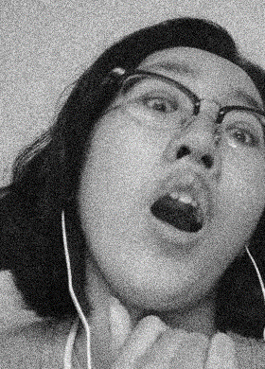
Whoa!
parang ganito
Sabihin mo “whoa” rn pag hindi mo sinabi, ibig sabihin ‘di mo ako mahal ☺

Slide 4
Ano bobo bat mo ginawa

Slide 5
timeline ng pagmamahalan naten
July 2016
May 2019
January 2020
Good Friends na may kalandian kahit si ashley talaga crush mo bitch
Revived friendship na may landian ulit pero mas lumandi pa
Pinaplano na naten pamilya at pagpapakasal naten <3
May 2018
September 2019
Strangers with memories kasi di mo feel vibe ko
Nahulog ako nahulog ka pero di ka sure kung nahulog ka tangina mo tapos ayaw mo magbigay ng assurance kasi di ka sure ampota edi sana di ka na lang umamin tangina mo gago

Slide 6
SEVENTEEN!!!
Congratulations on finally turning

Slide 7
204 months old
887 weeks and 1 day old
6210 days old
or
or
or

Slide 8
149,040 hours old
8,942,400 minutes old
536,544,000 seconds old
or
or
or

Slide 9
“Putangina mo.”
—Malena Riz C. Ballon

Slide 10
A year I spent with you :>
Gagawa sana ako ng compilation of pictures chronologically kaso naisip ko wag na muntanga iwan ko na lang title dito sayang naman pagttype ko

Slide 11
So ito na lang behind stories ng mga following pictures hehe <3
Subtitle kase ampanget pag wala

Slide 12
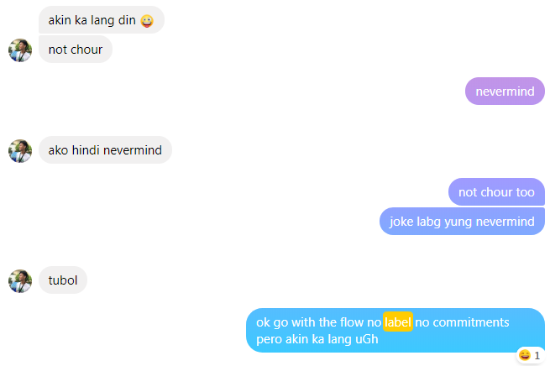
KADIRI ANG TANGA!!!!!!!!

Slide 13
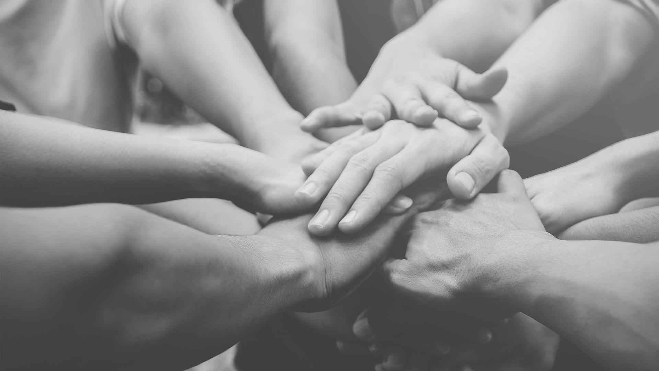
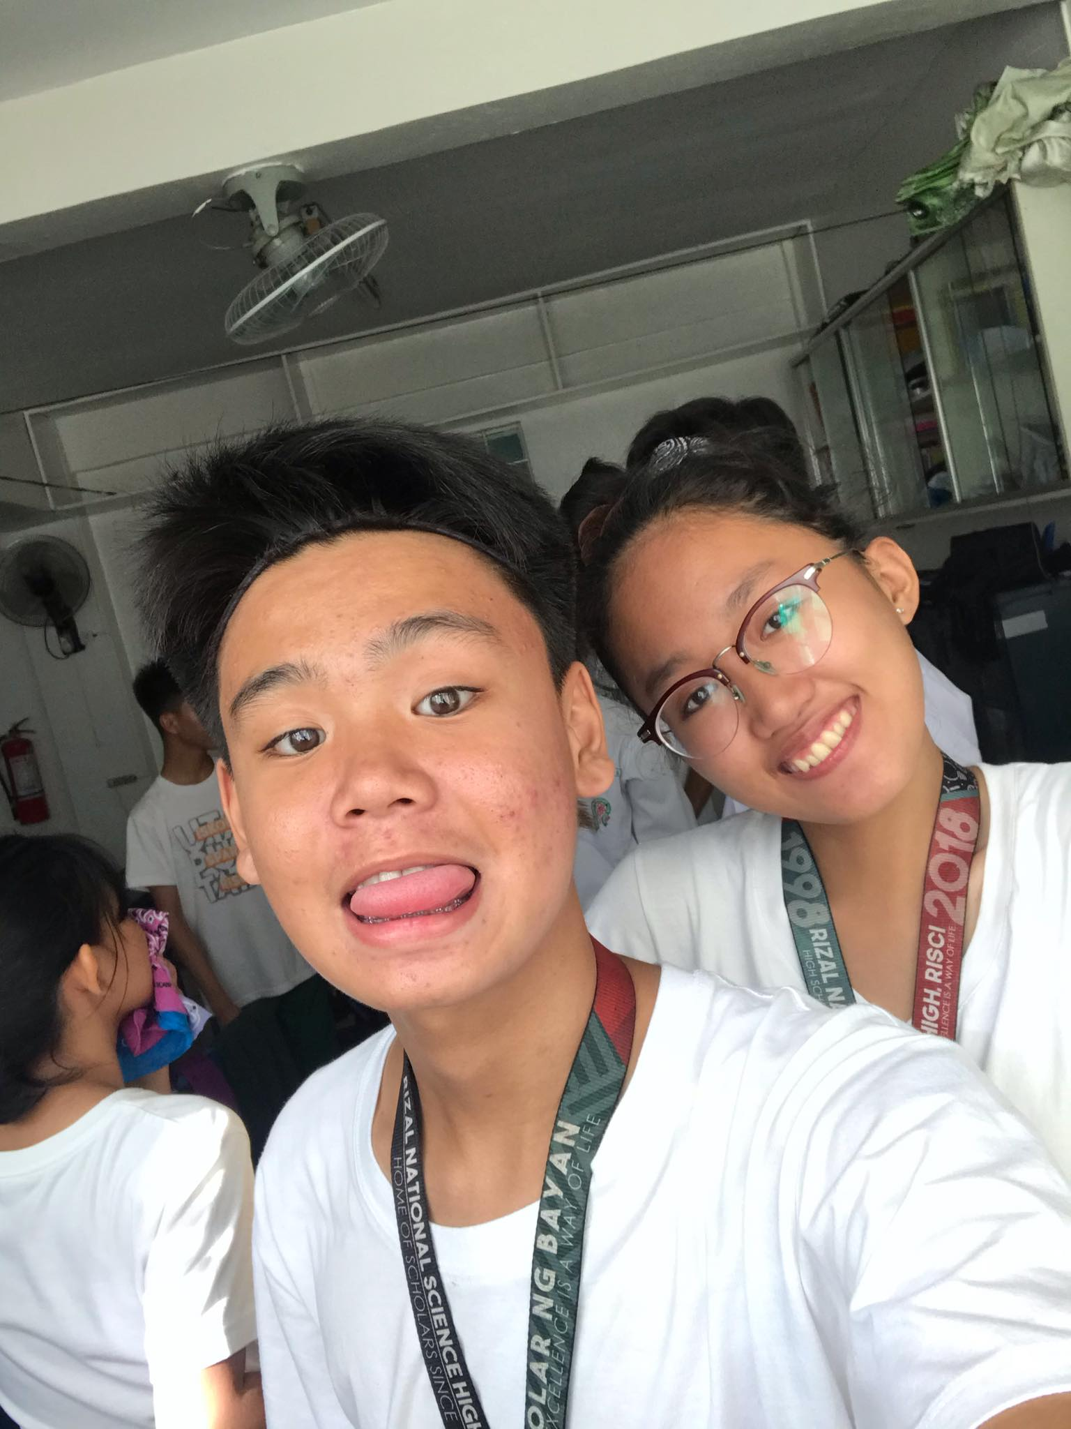
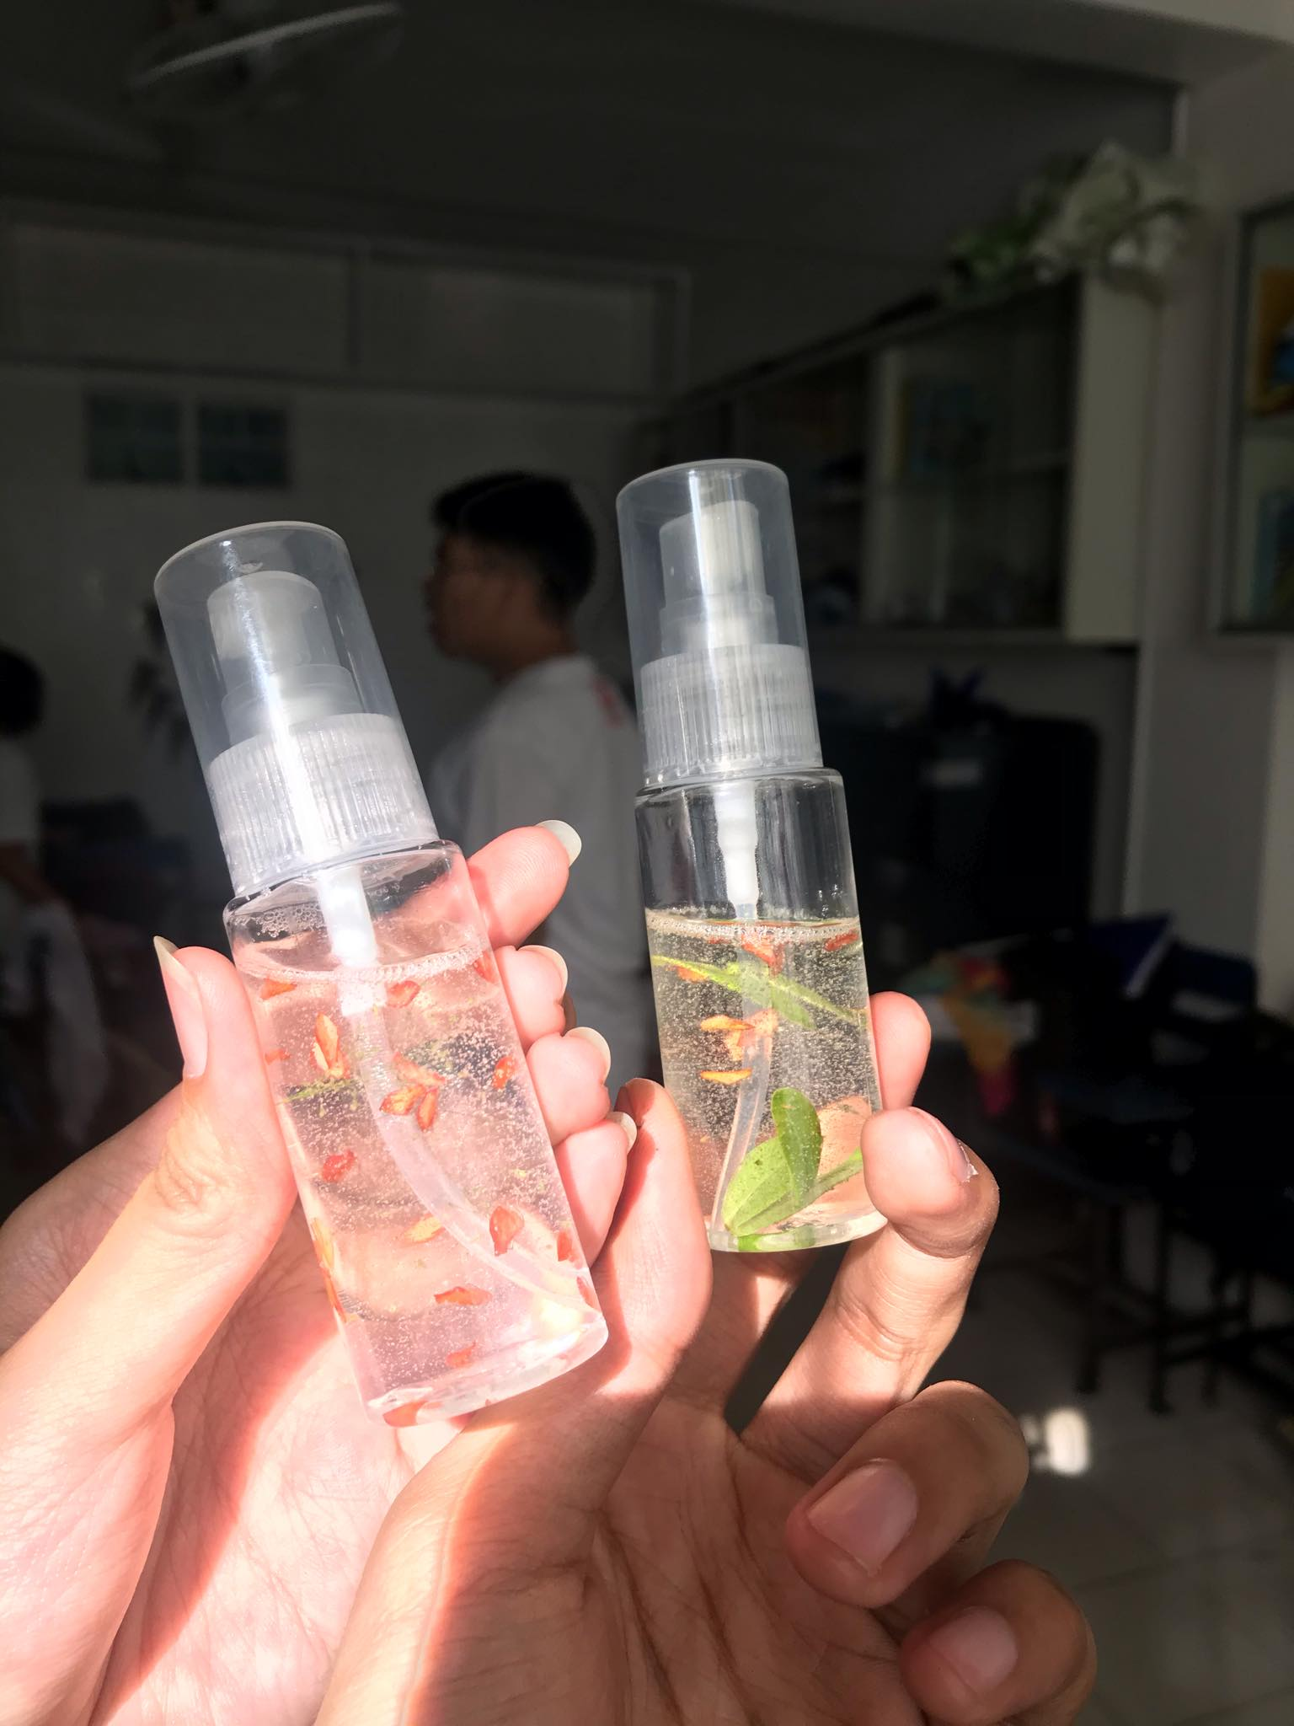
HEHEHE MAM VINA I LOVE YOU TAS GINAYA MO SANTAN KO TAPOS NAGPAPOLL TAYO PERO ANG PANGET TALAGA NG SAYO OK LANG YAN ☺ 10-07-19

Slide 14
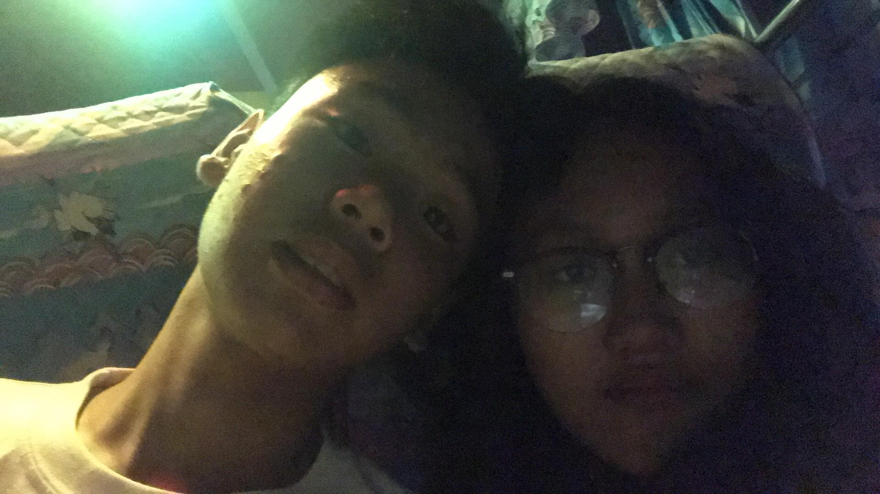
And here too! 10-12-19
Hehehe super thankful po ako sa inyo nung araw na to bukod sa paglalandian natin sa likod ni sir arada, ikaw talaga bumuo ng araw ko that day, tho hindi naging maganda yung the rest ng oras before niyan for me and umiyak ako pero thank you so much for being there at least nagging makabuluhan yung tour ko dahil sa gabing yan hehehehe one of the days na ittreasure ko na kasama kita no joke ;((

Slide 15
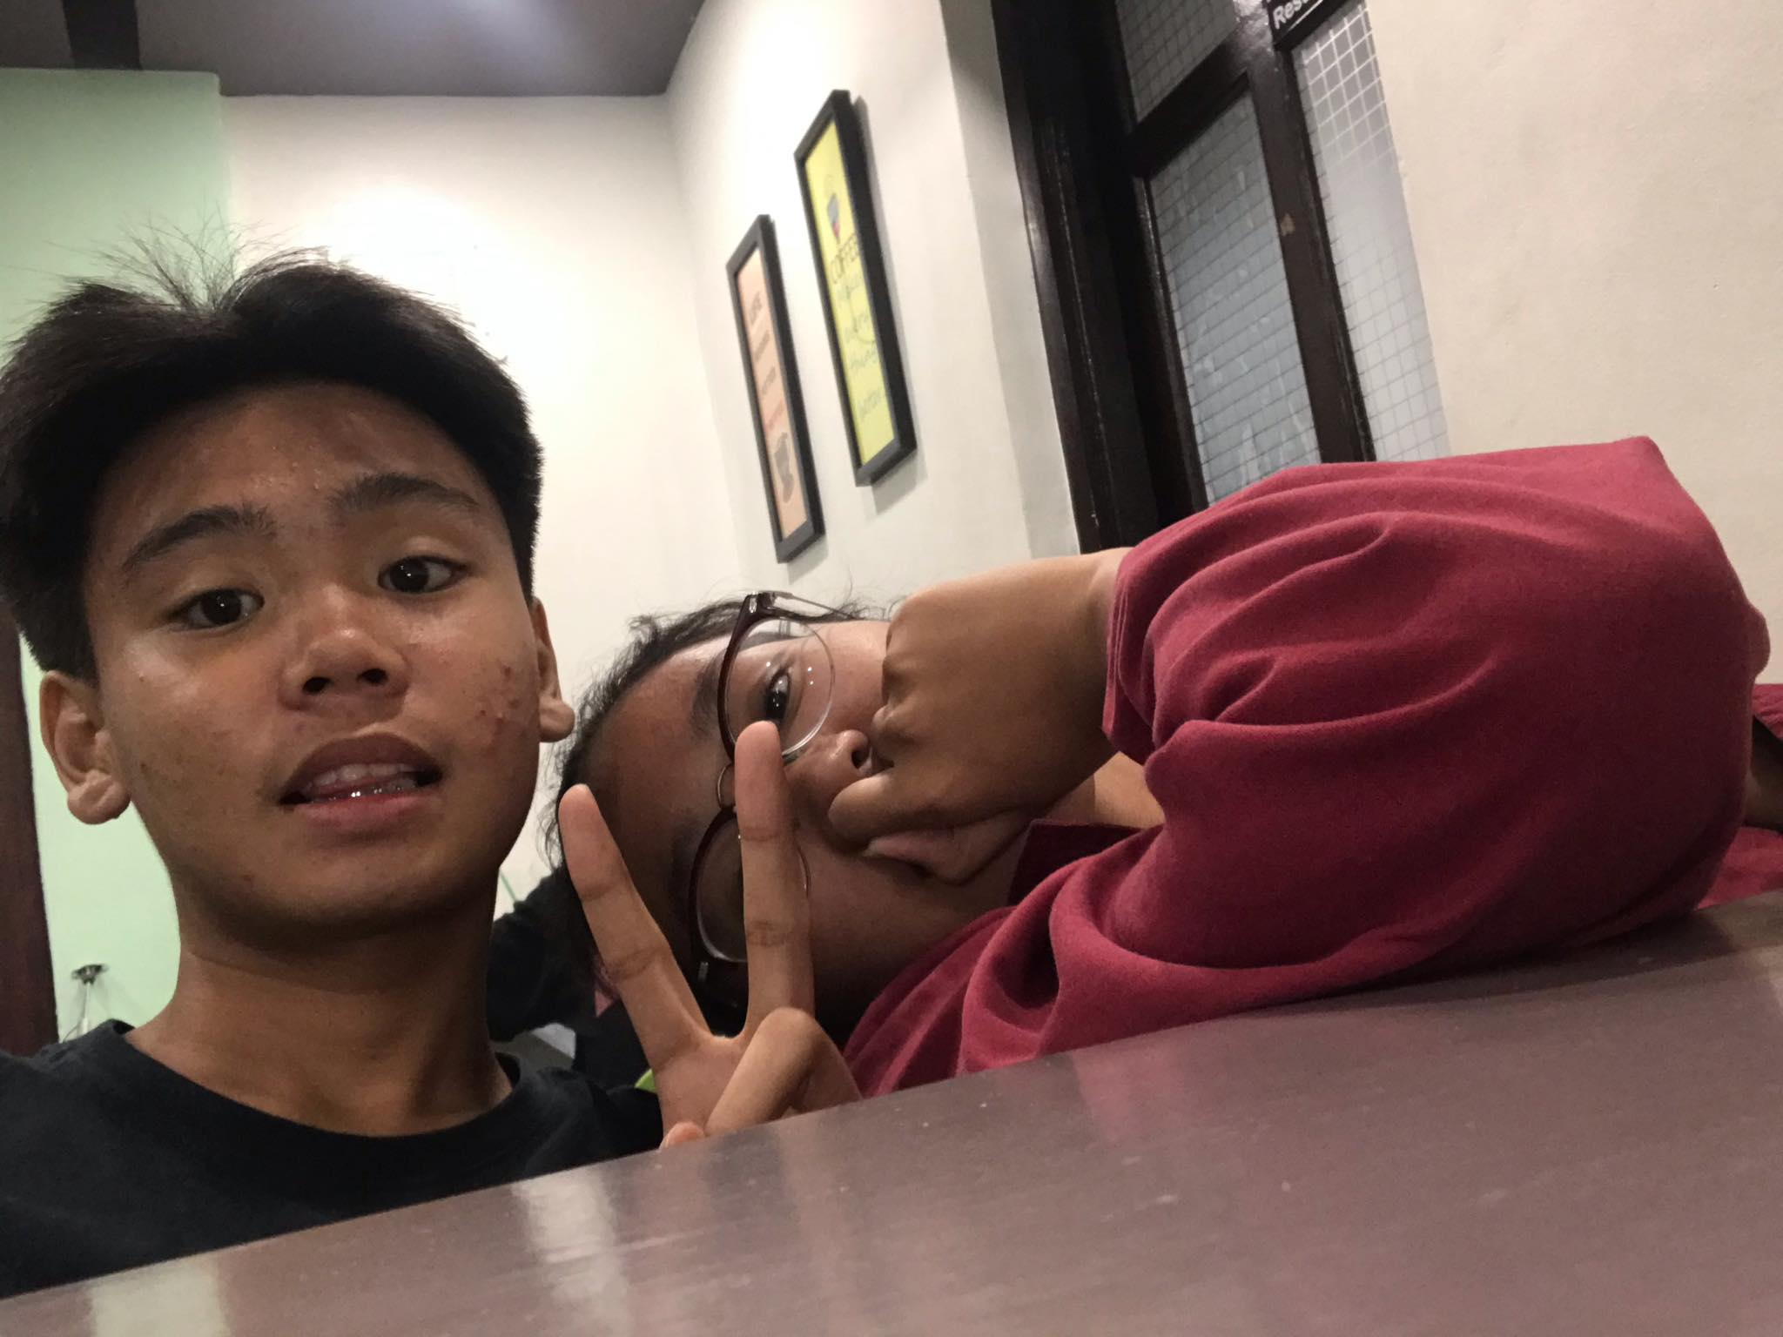
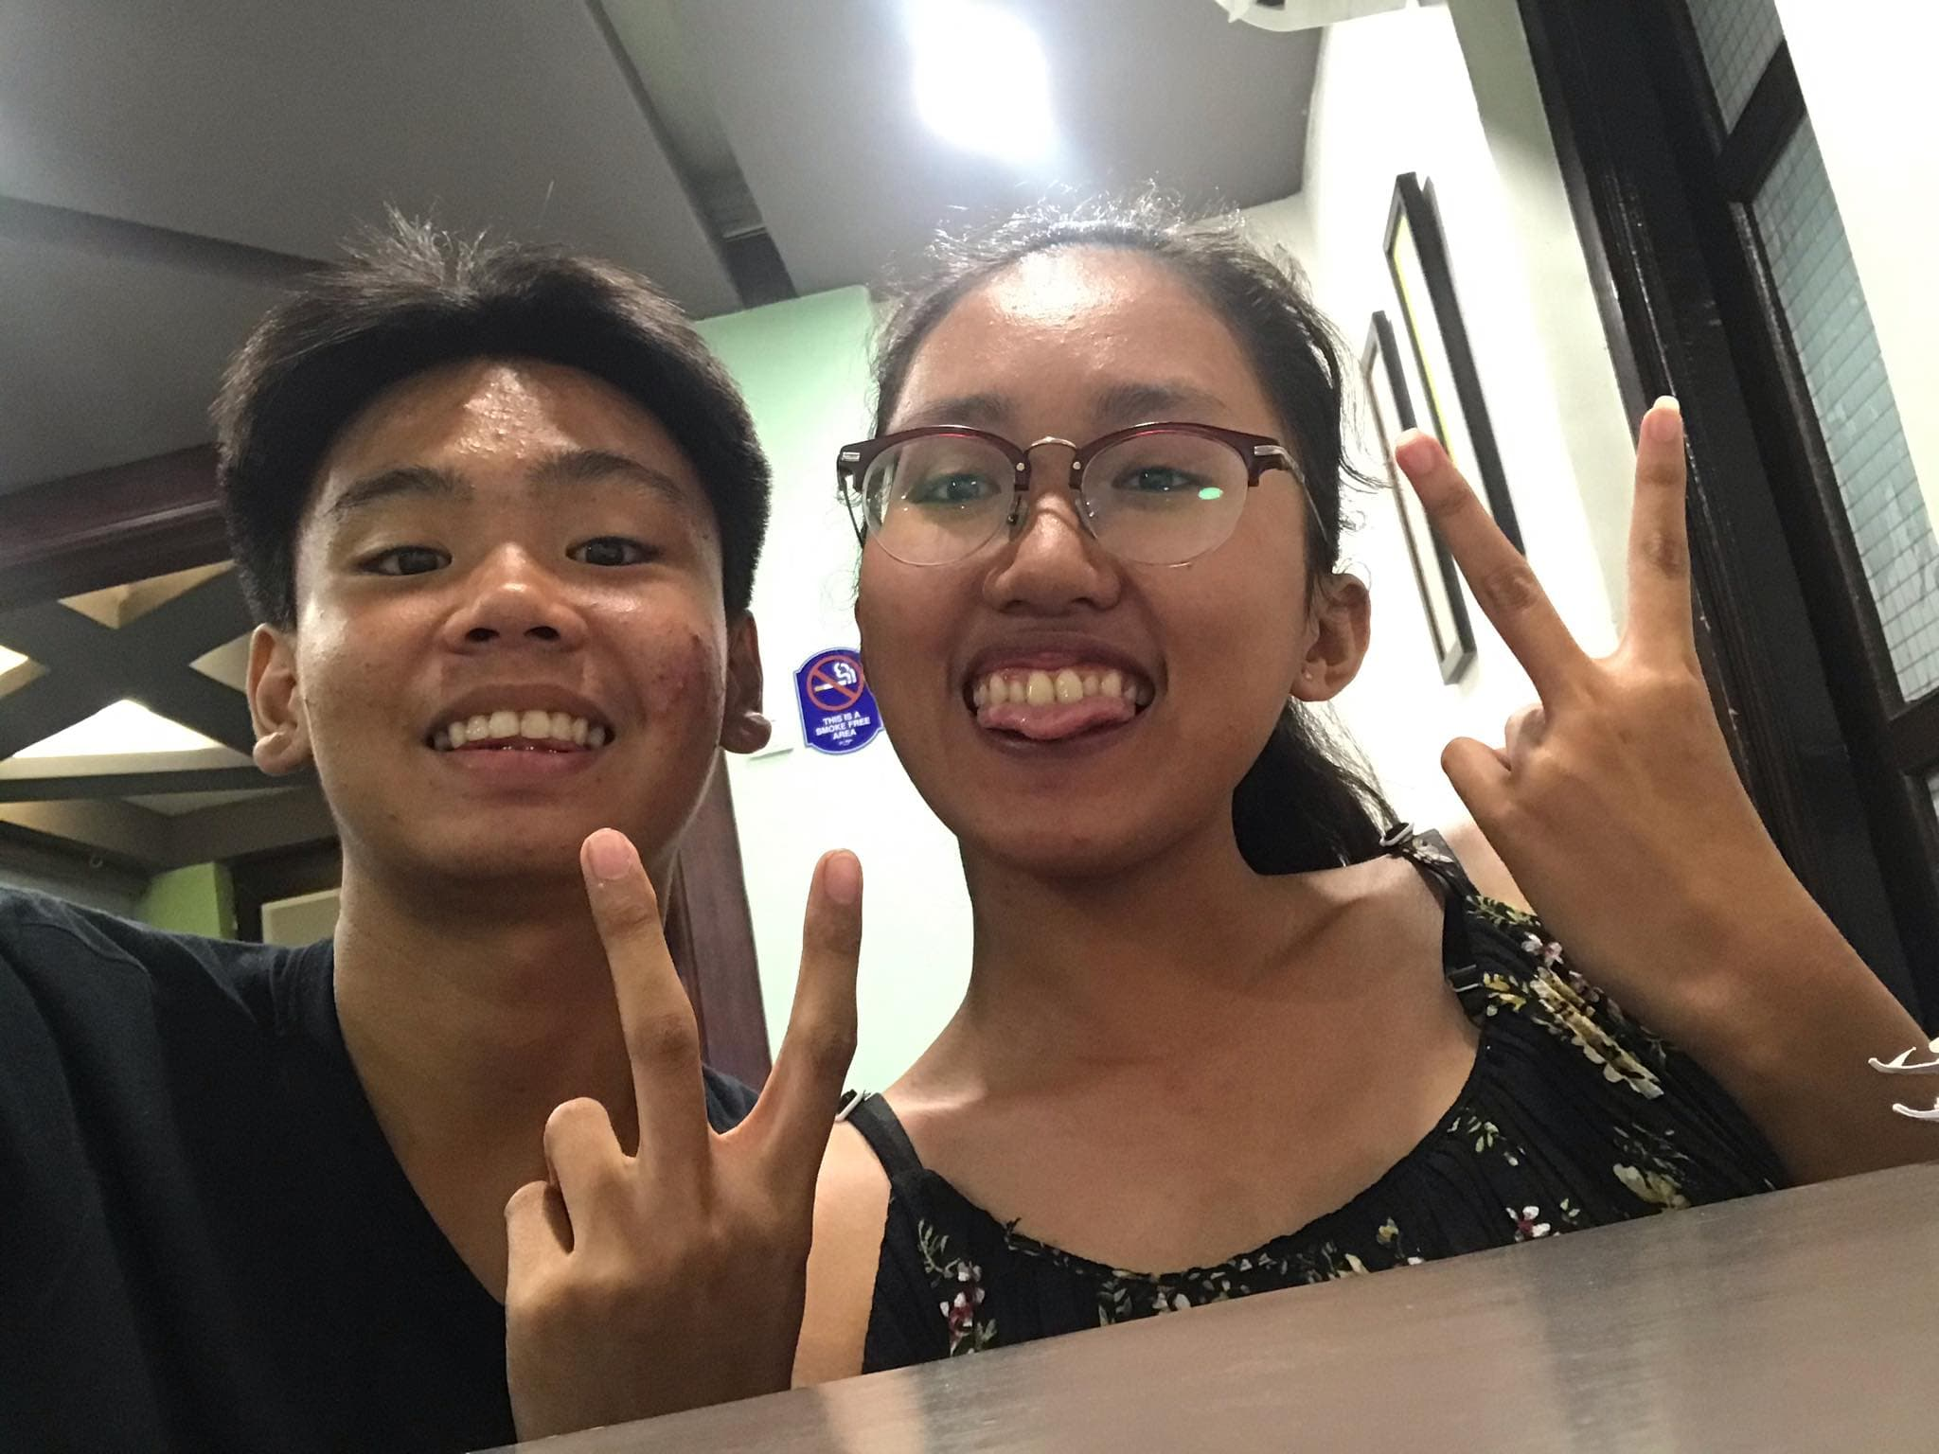
Review review review 10-14-19
Nagreview tayo nung topics sa TLE na di naman pala kasama pero ok lang masaya naman hehe <3 naghiwalay pa tayong table kasi distraction ako heehehehhehe :*** yan din yung day na umabsent tayo para magreview hehehe

Slide 16
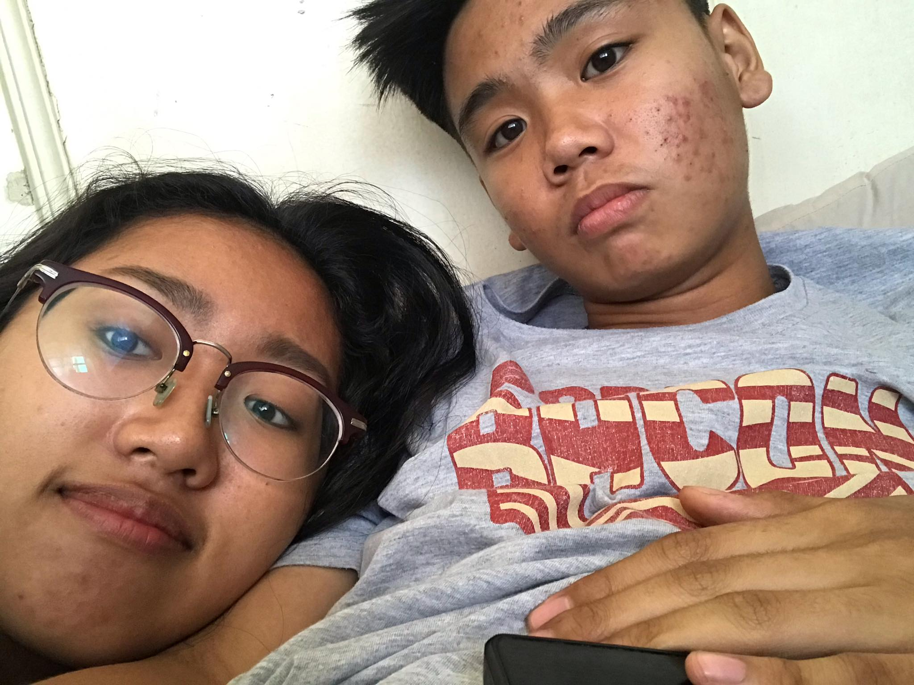
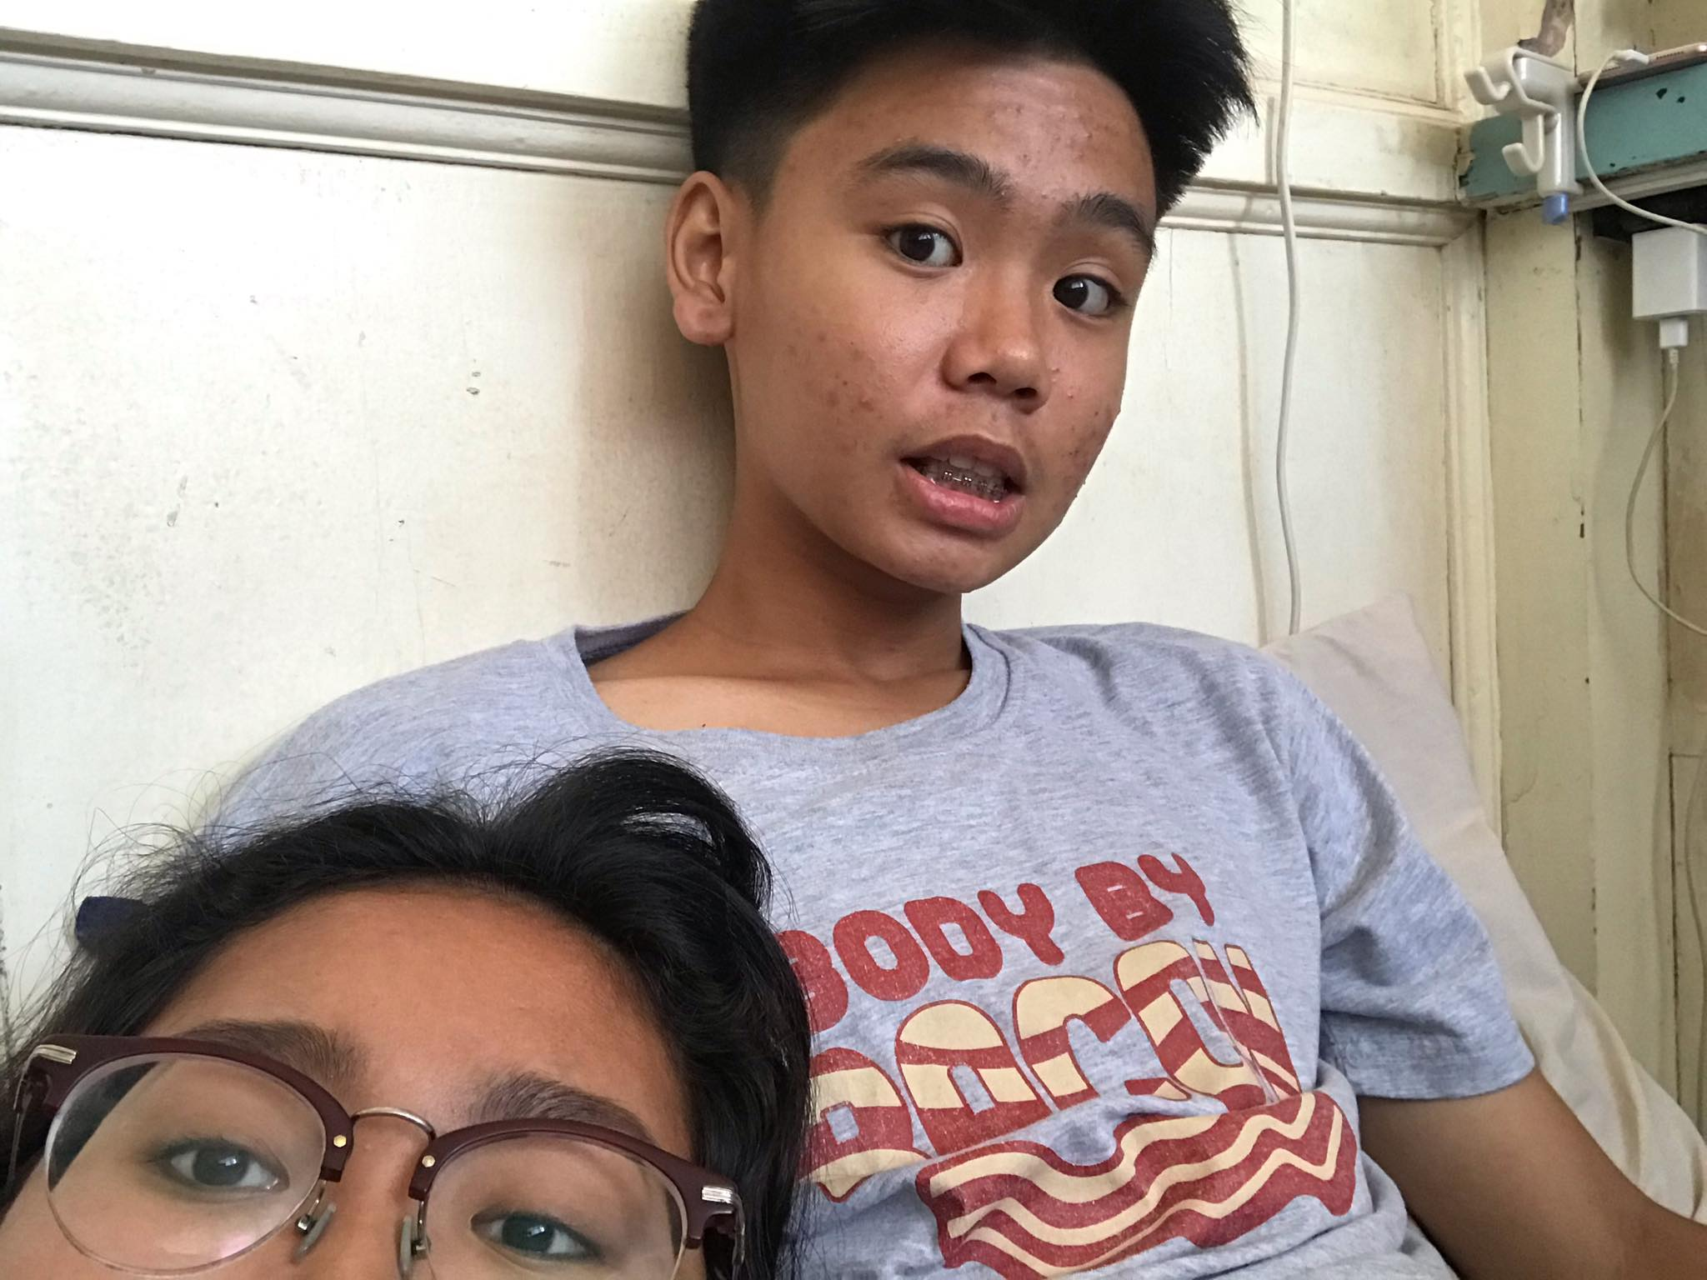
A picture is worth a thousand words
Birthday ni ate mineli hehe tumambay muna tayo kayla aaron and cuddle hehehe I miss you 10-25-19

Slide 17
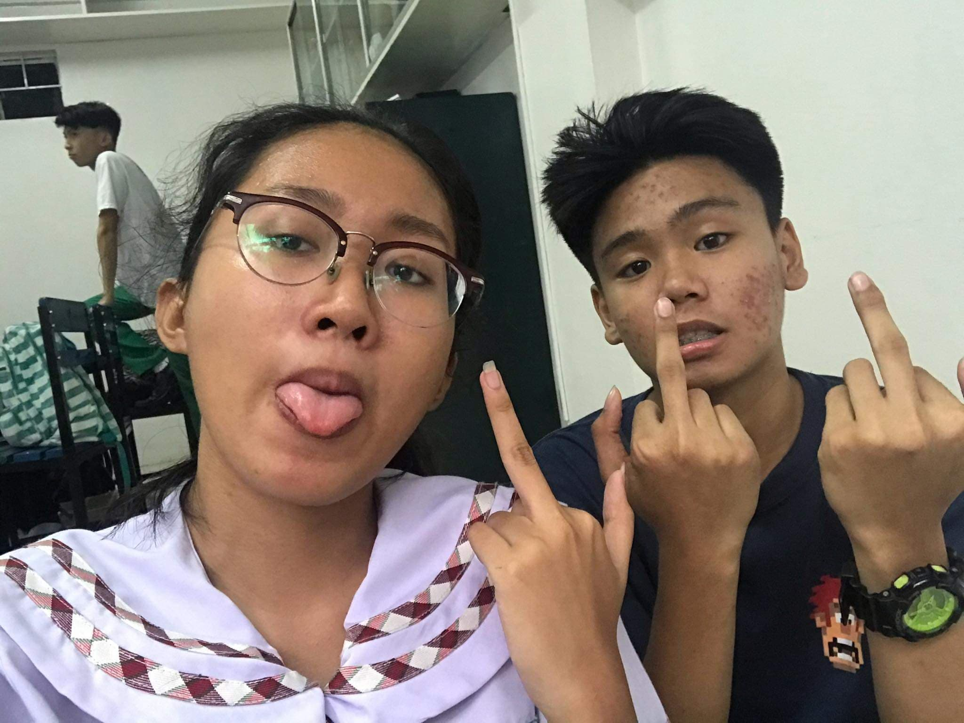
Pakyu kay jonah 11-07-19
heheheheheh

Slide 18
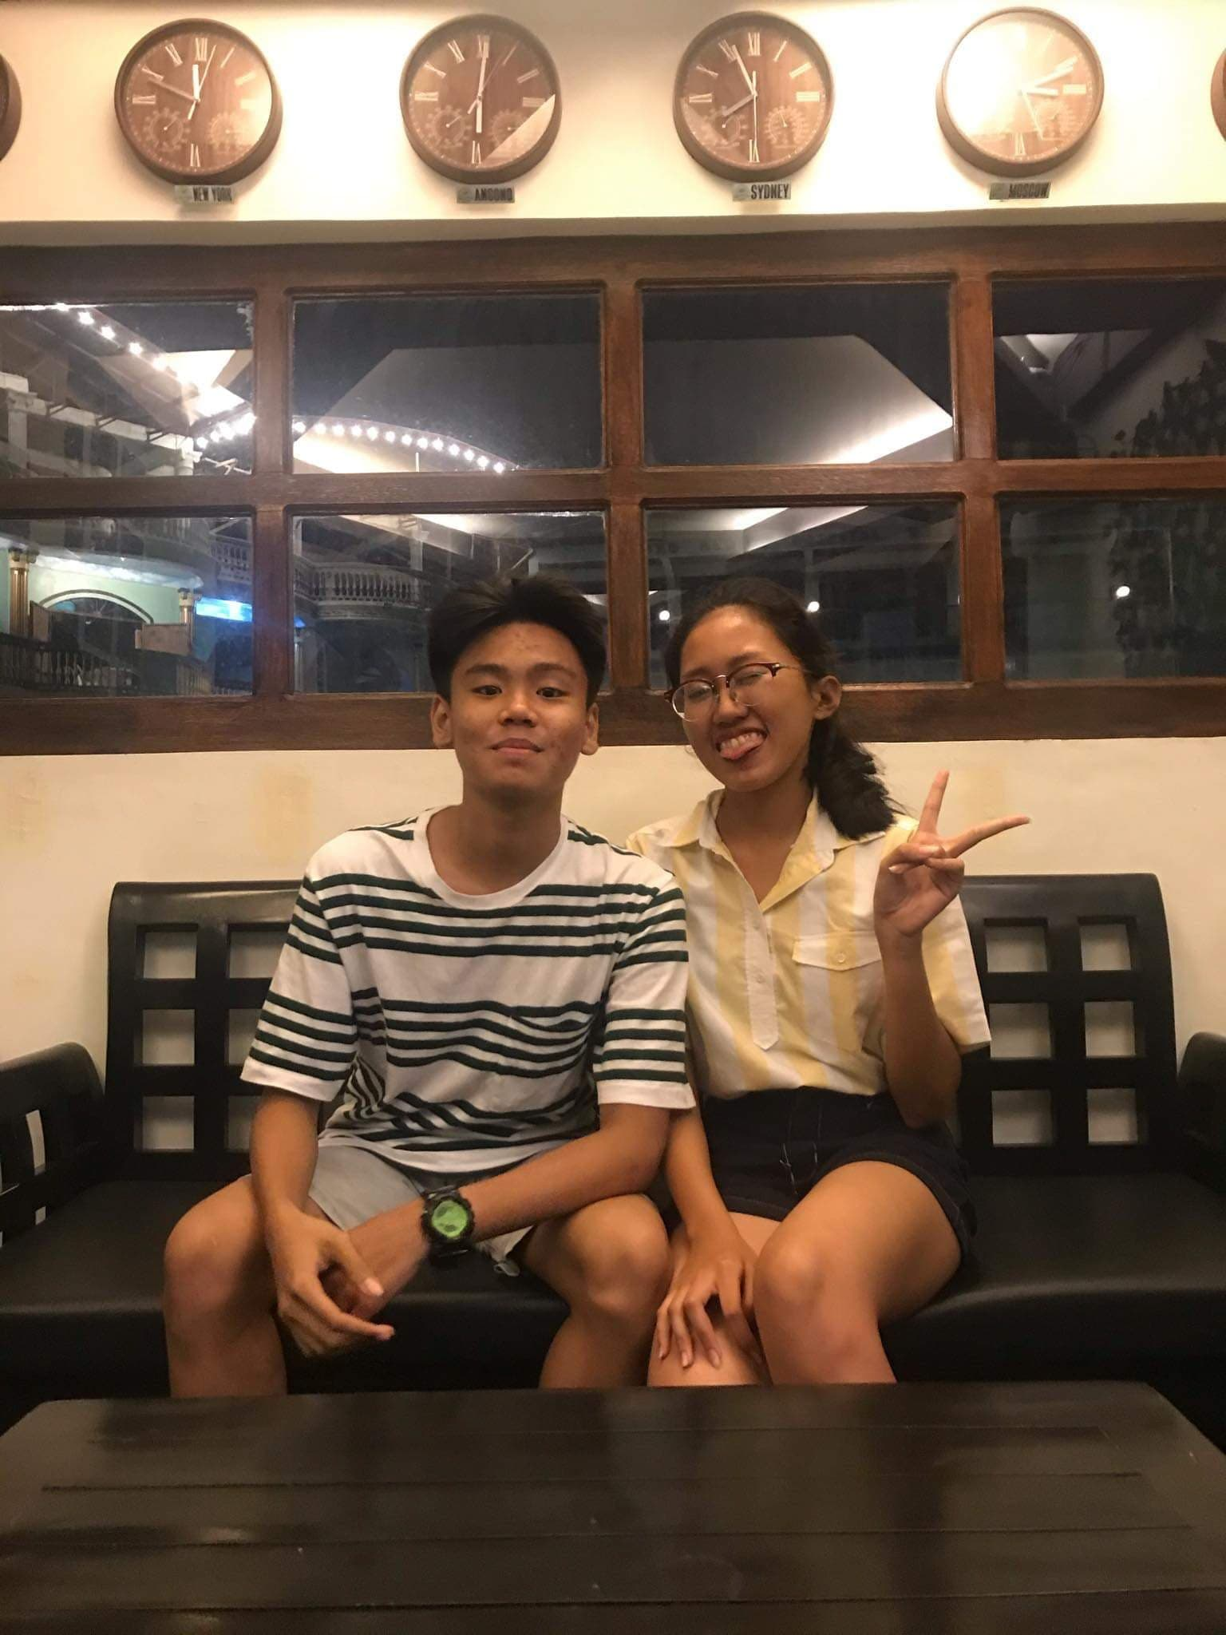
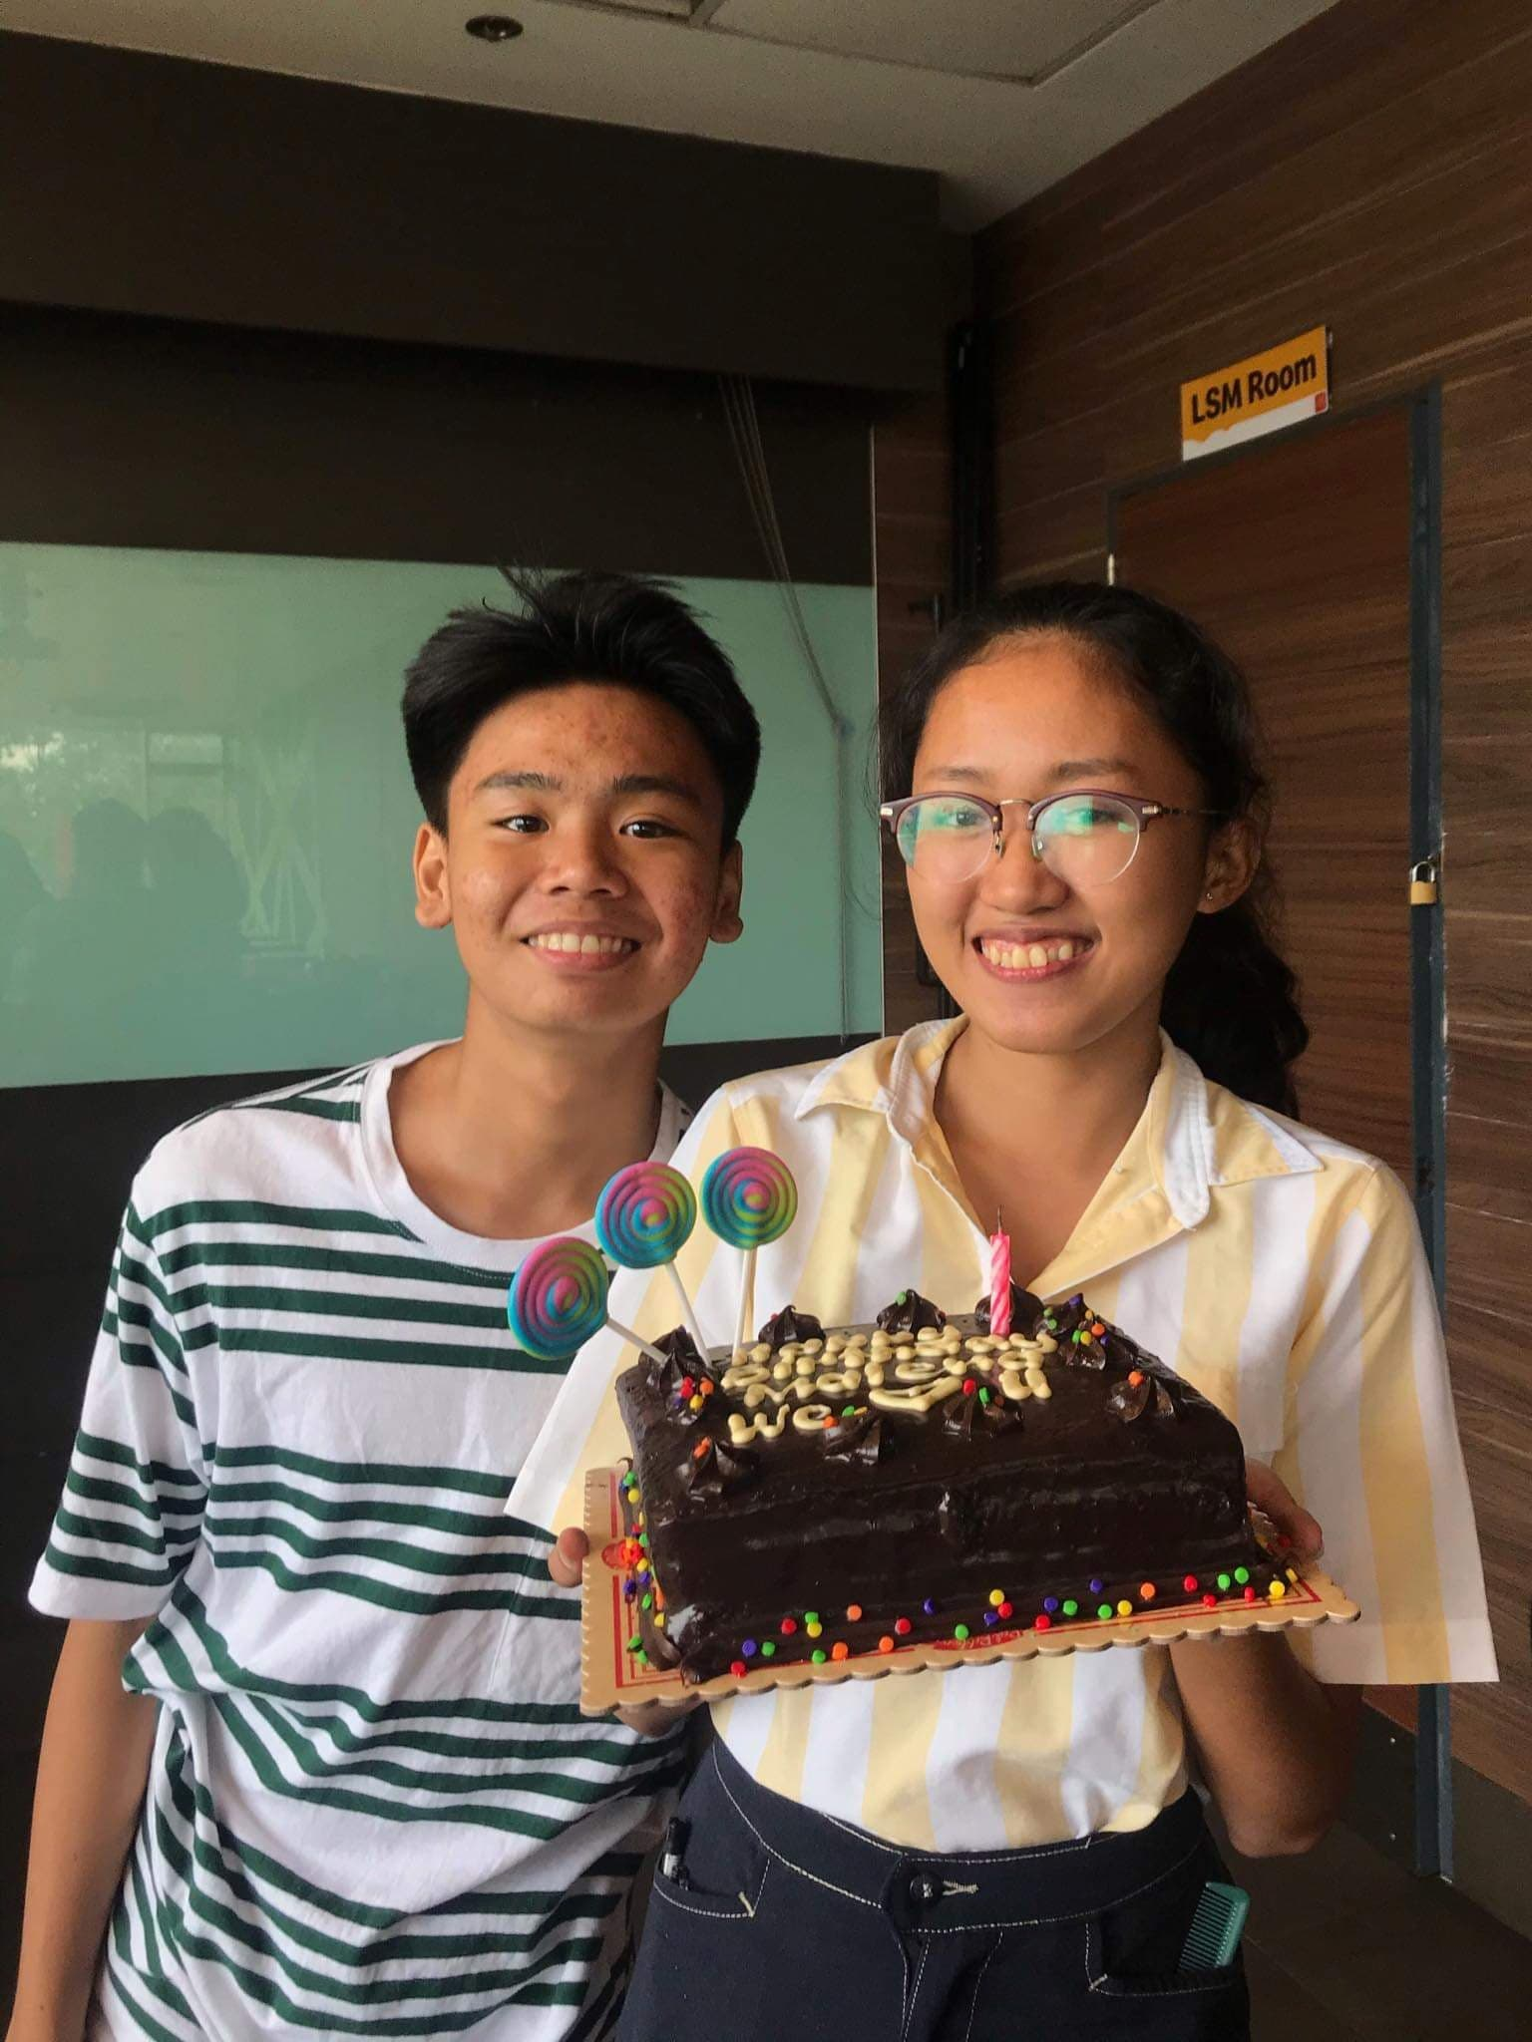
My 17th bday celeb 11-08-19
Thank you so much for making this day more special than what I expected ;( you’re one of the greatest blessings in my life sa totoo lang and of course hindi lang ngayon maging sa the rest ng buhay ko magiging thankful po ako sa inyo ;))

Slide 19
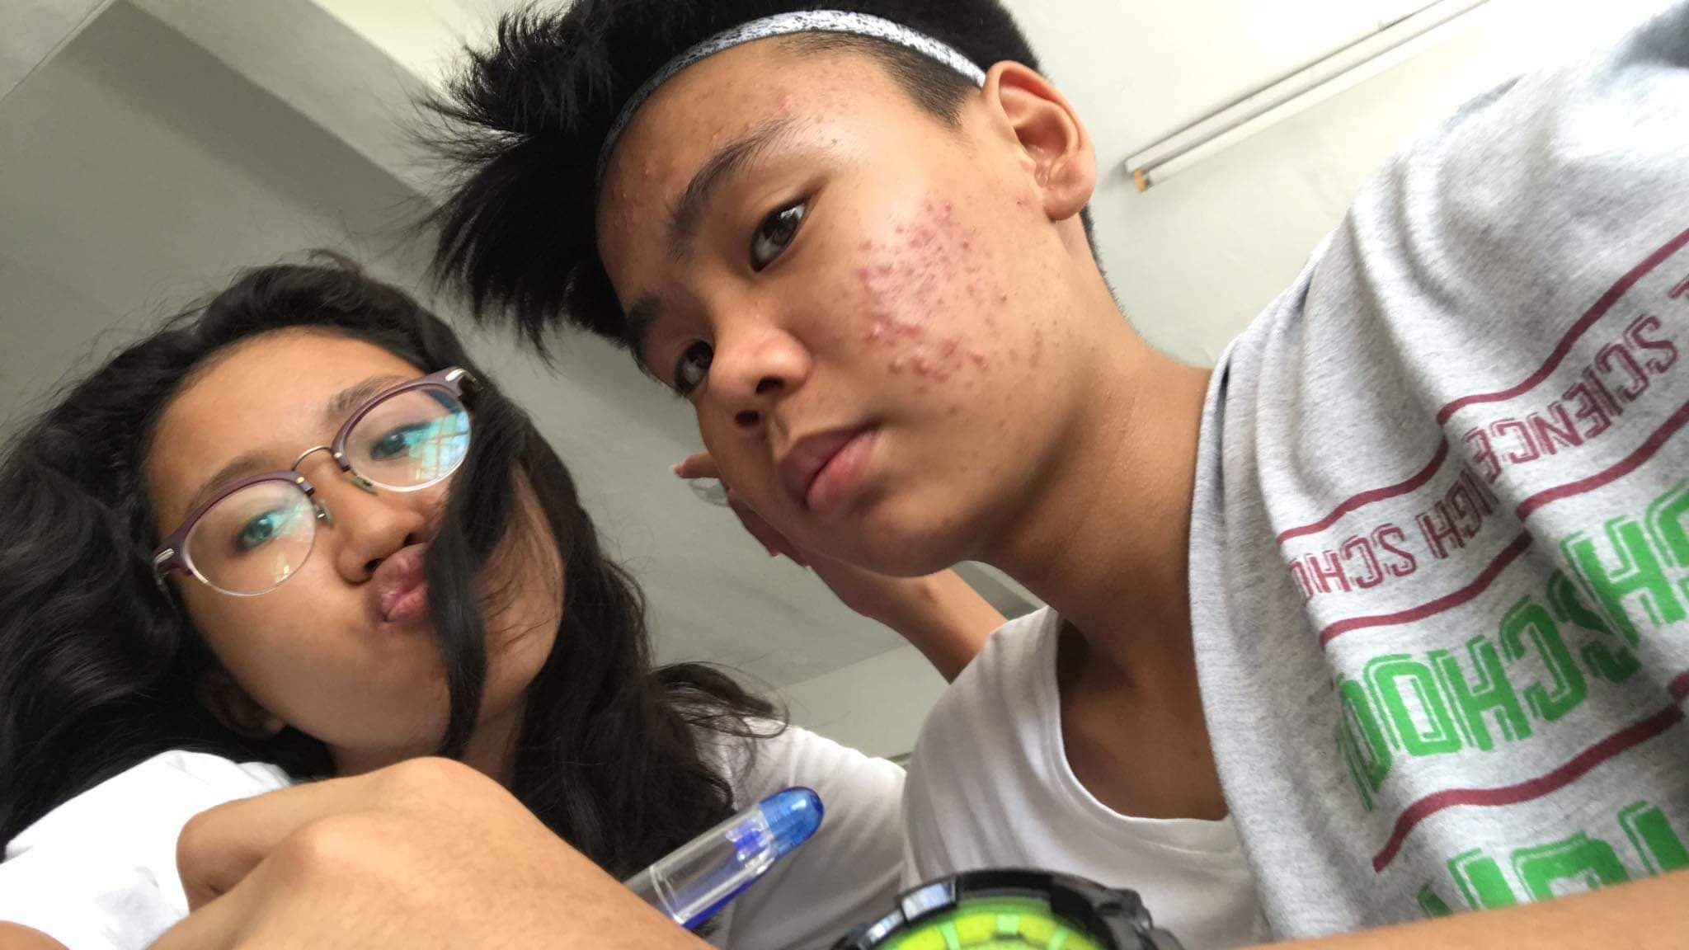
Busy ka this day pero ginugulo kita heheheh idk day
heheheheheh

Slide 20
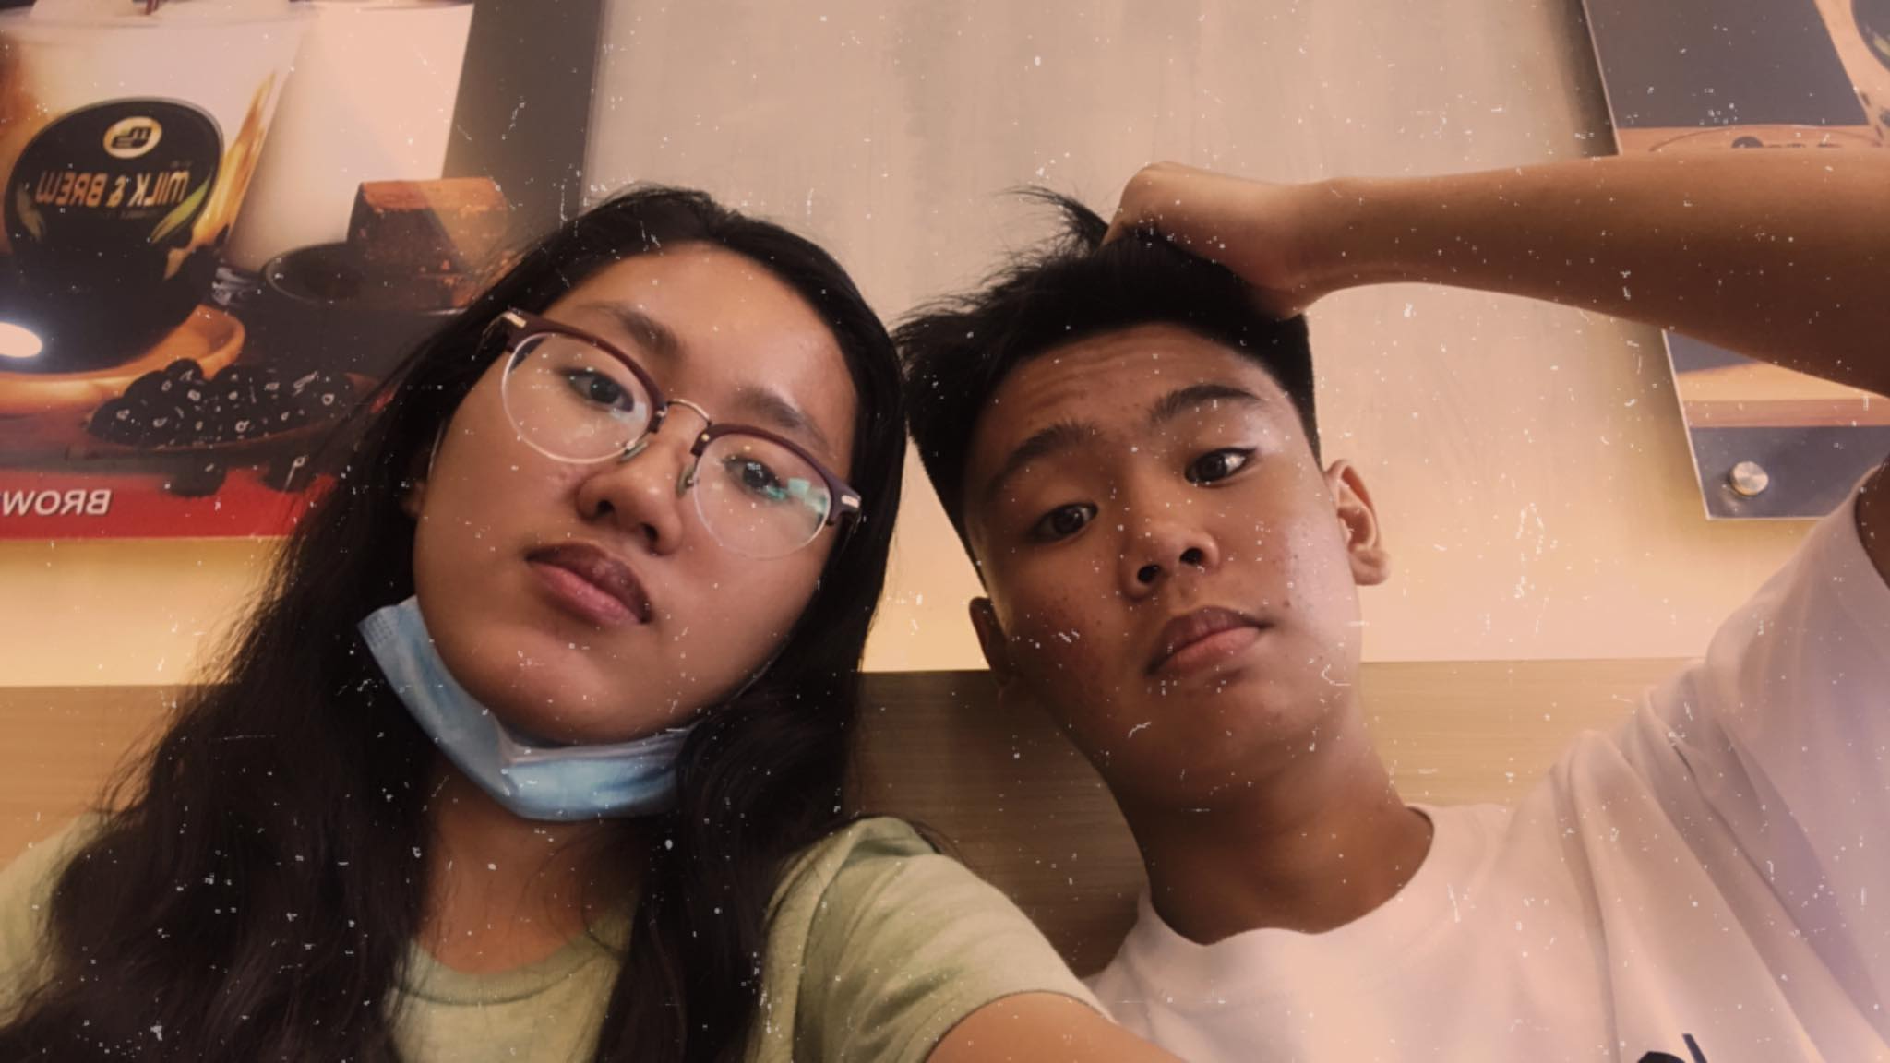
A picture is worth a thousand words
Nahuli tayo ni Richard hehehe idk day too

Slide 21
Random pics cominthru

Slide 22
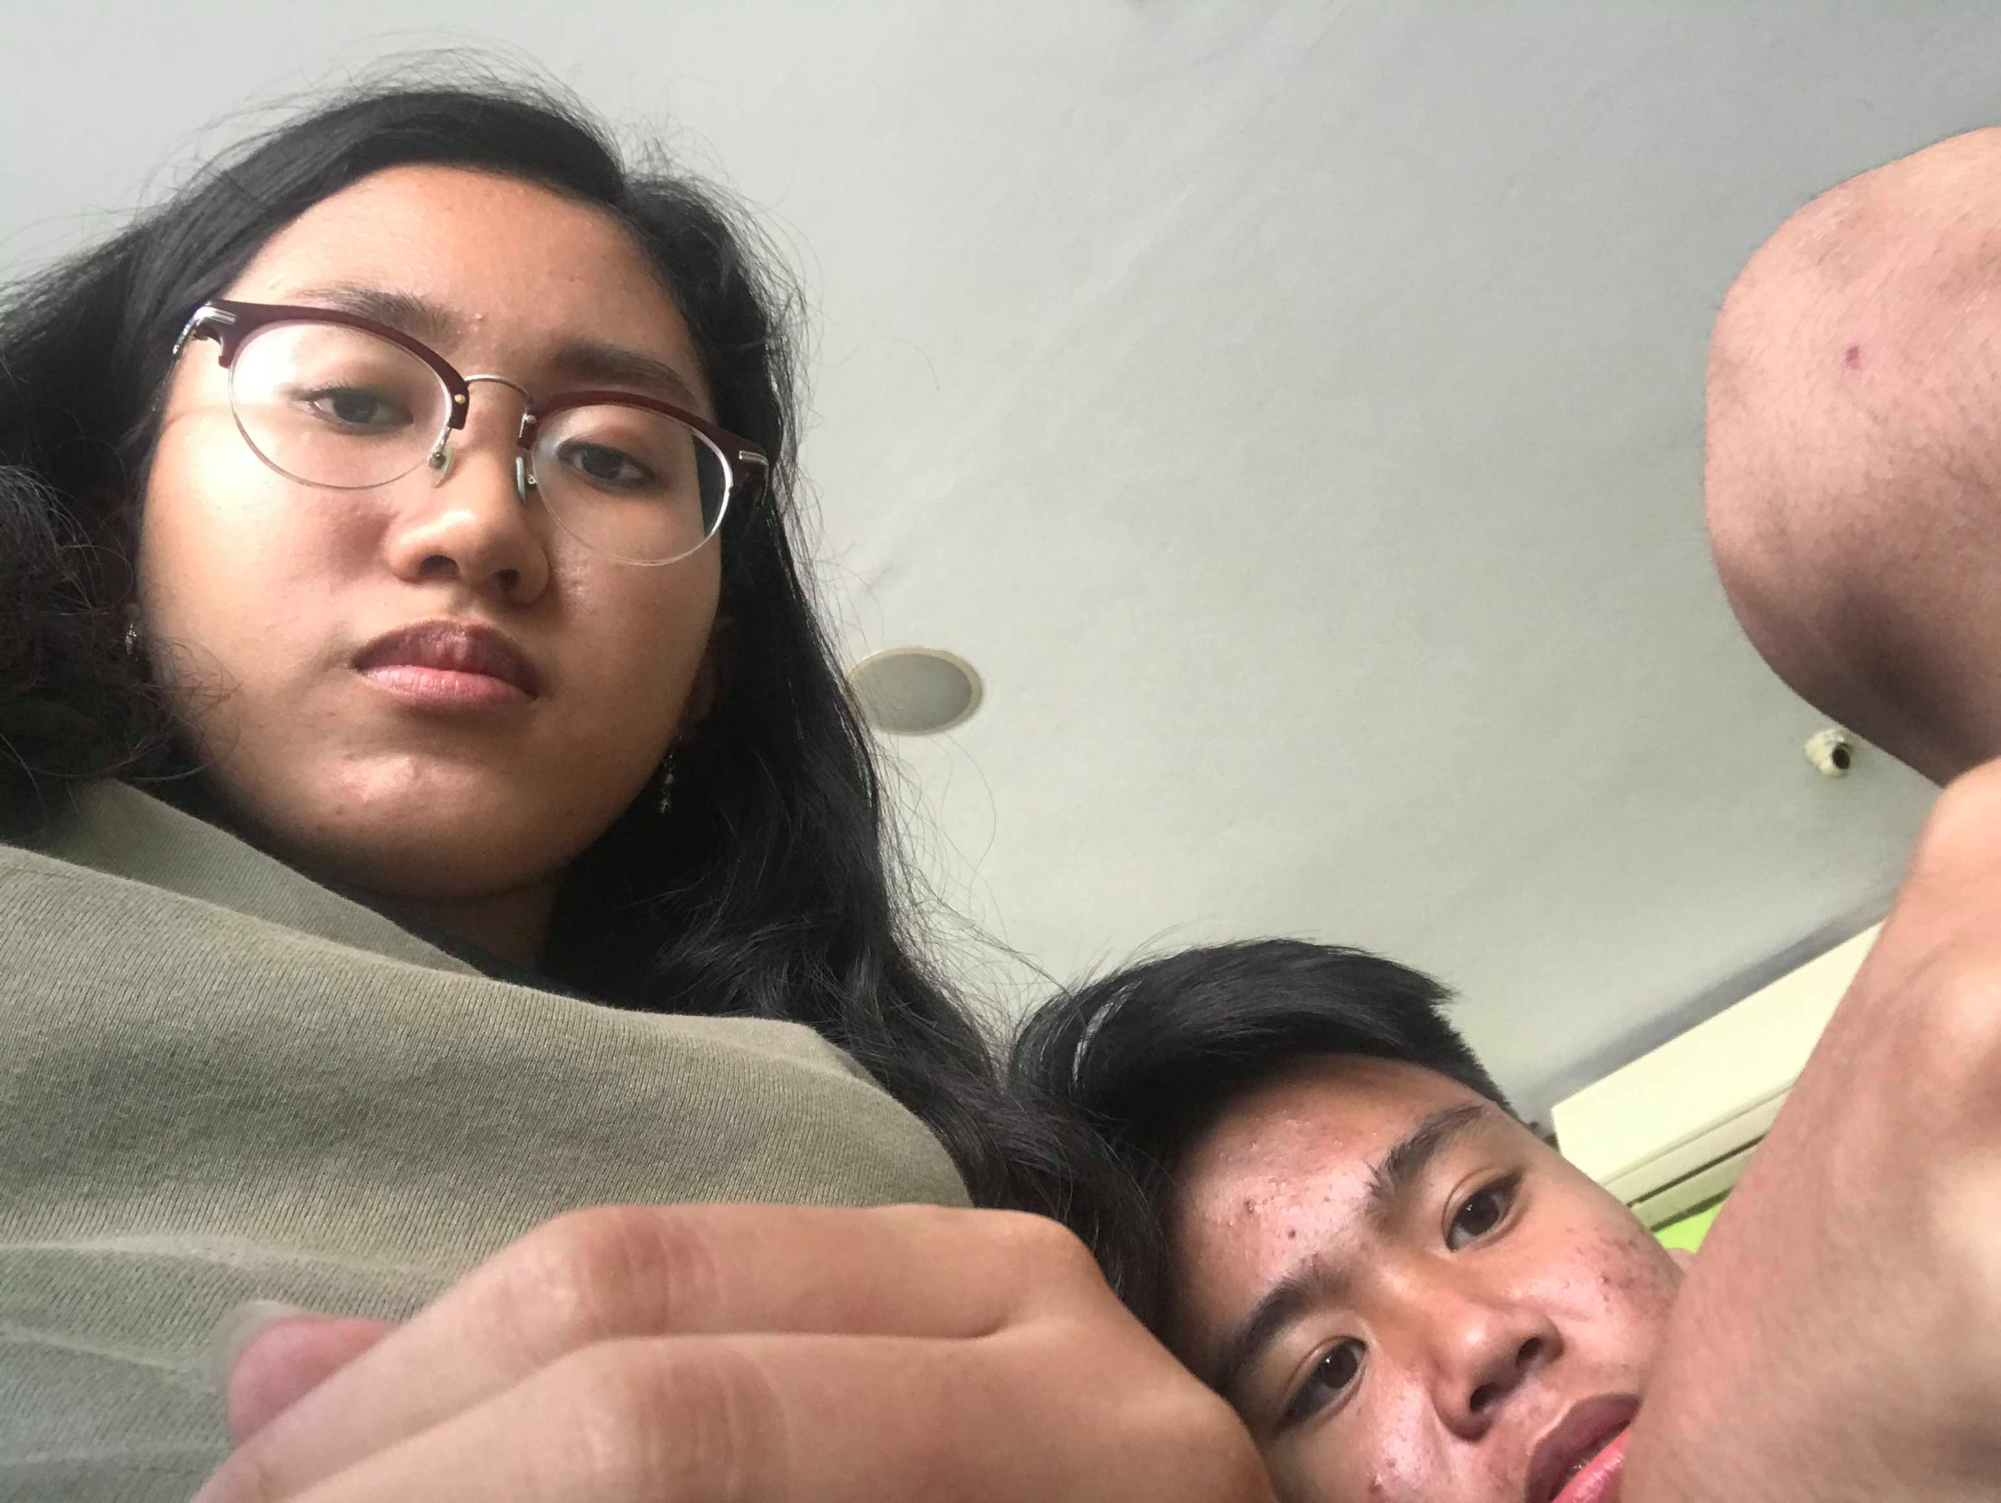
Bat ka nakahiga sa dede ko
Subtitle ule

Slide 23
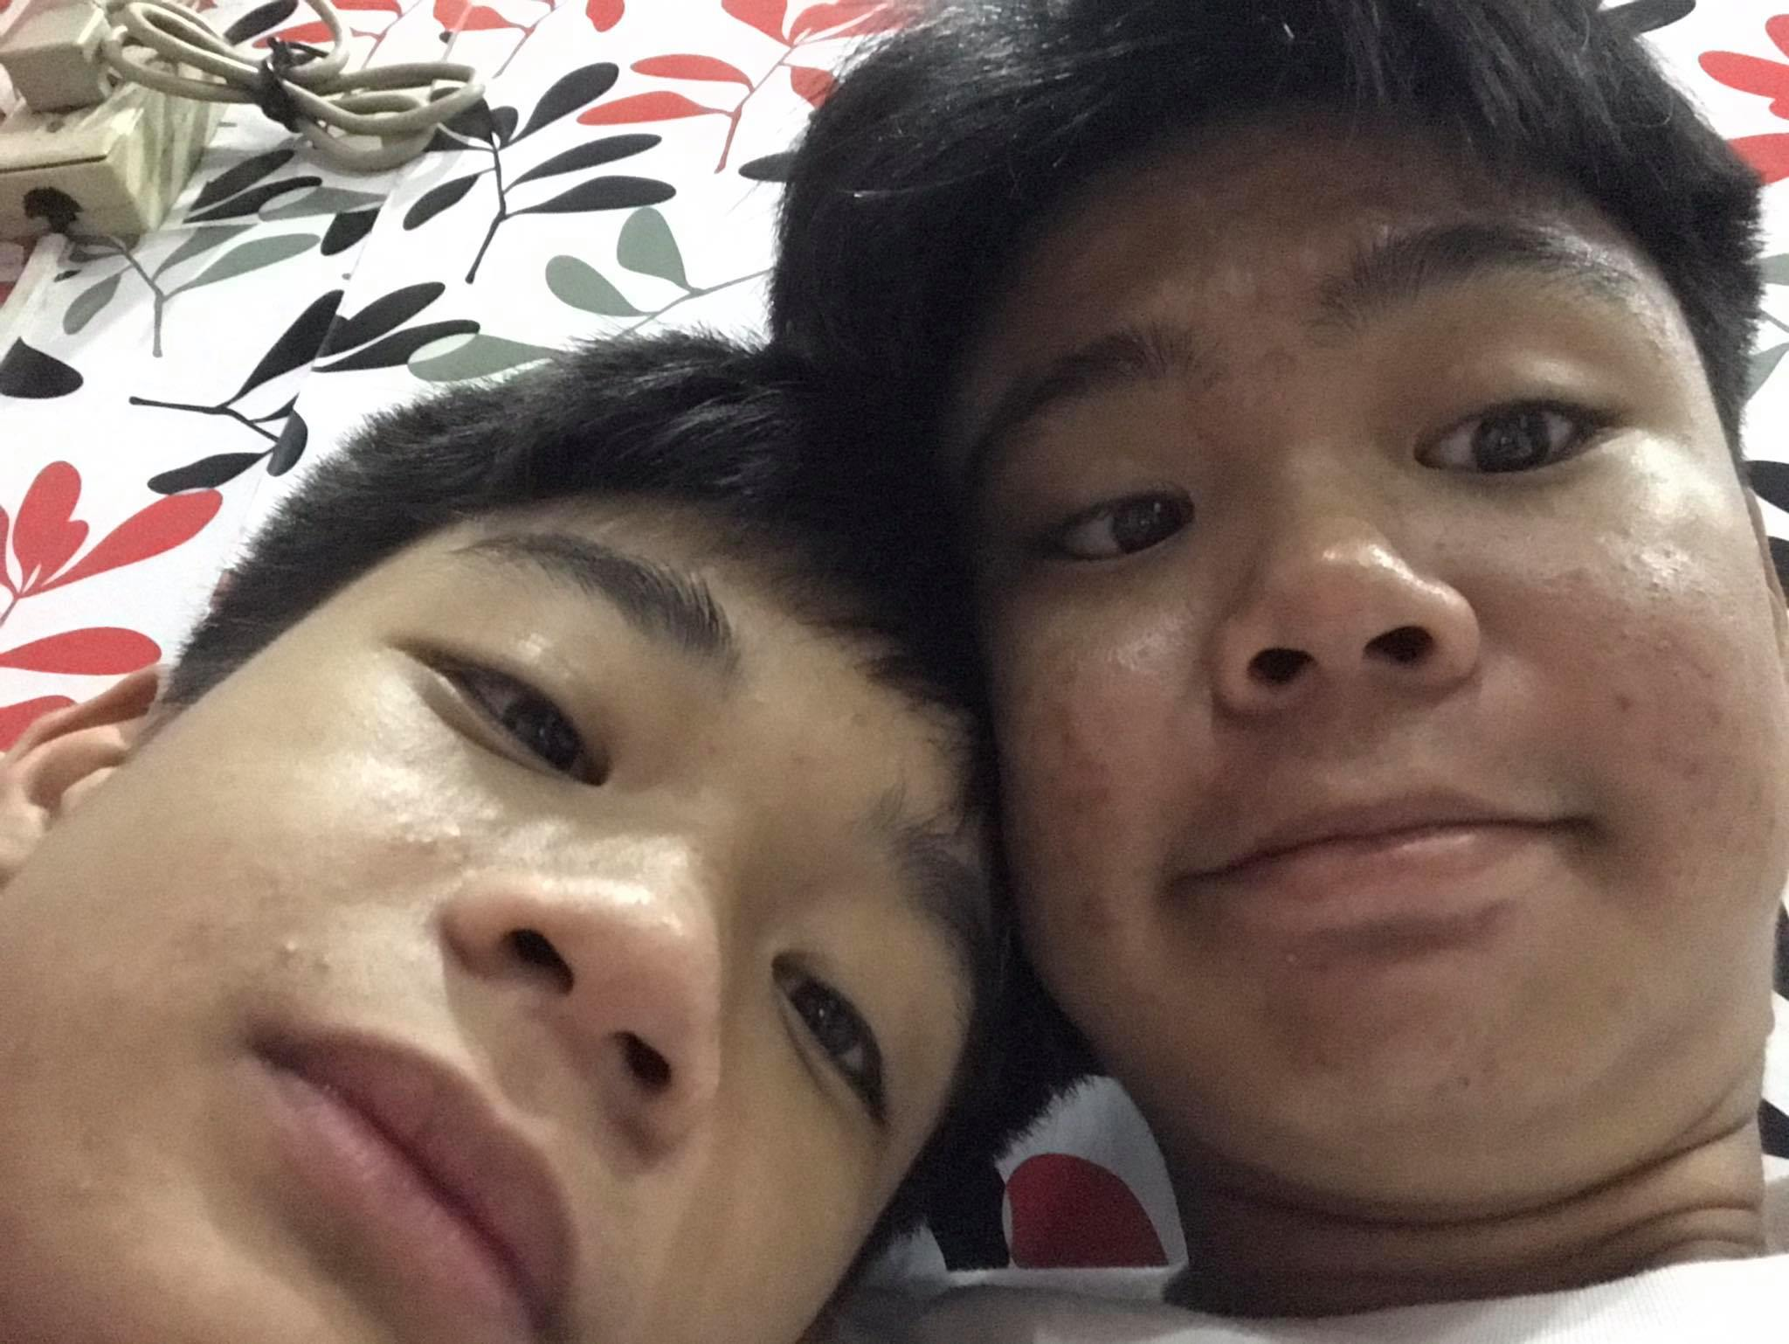
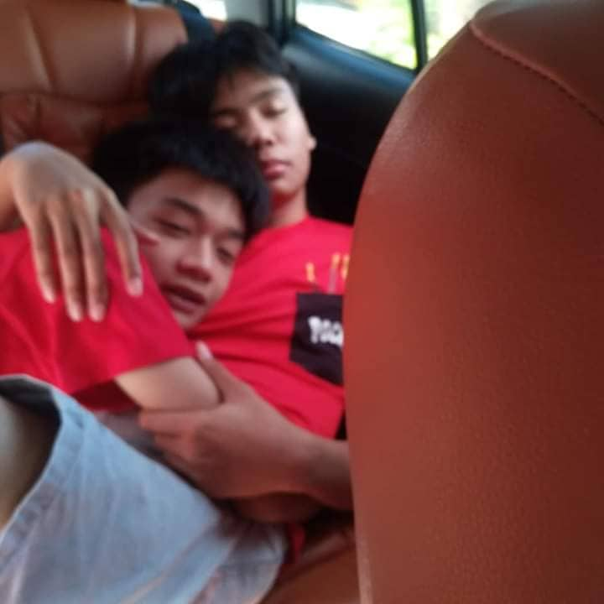
A picture is worth a thousand words
Cute niyo hehehe magbati na kayo

Slide 24
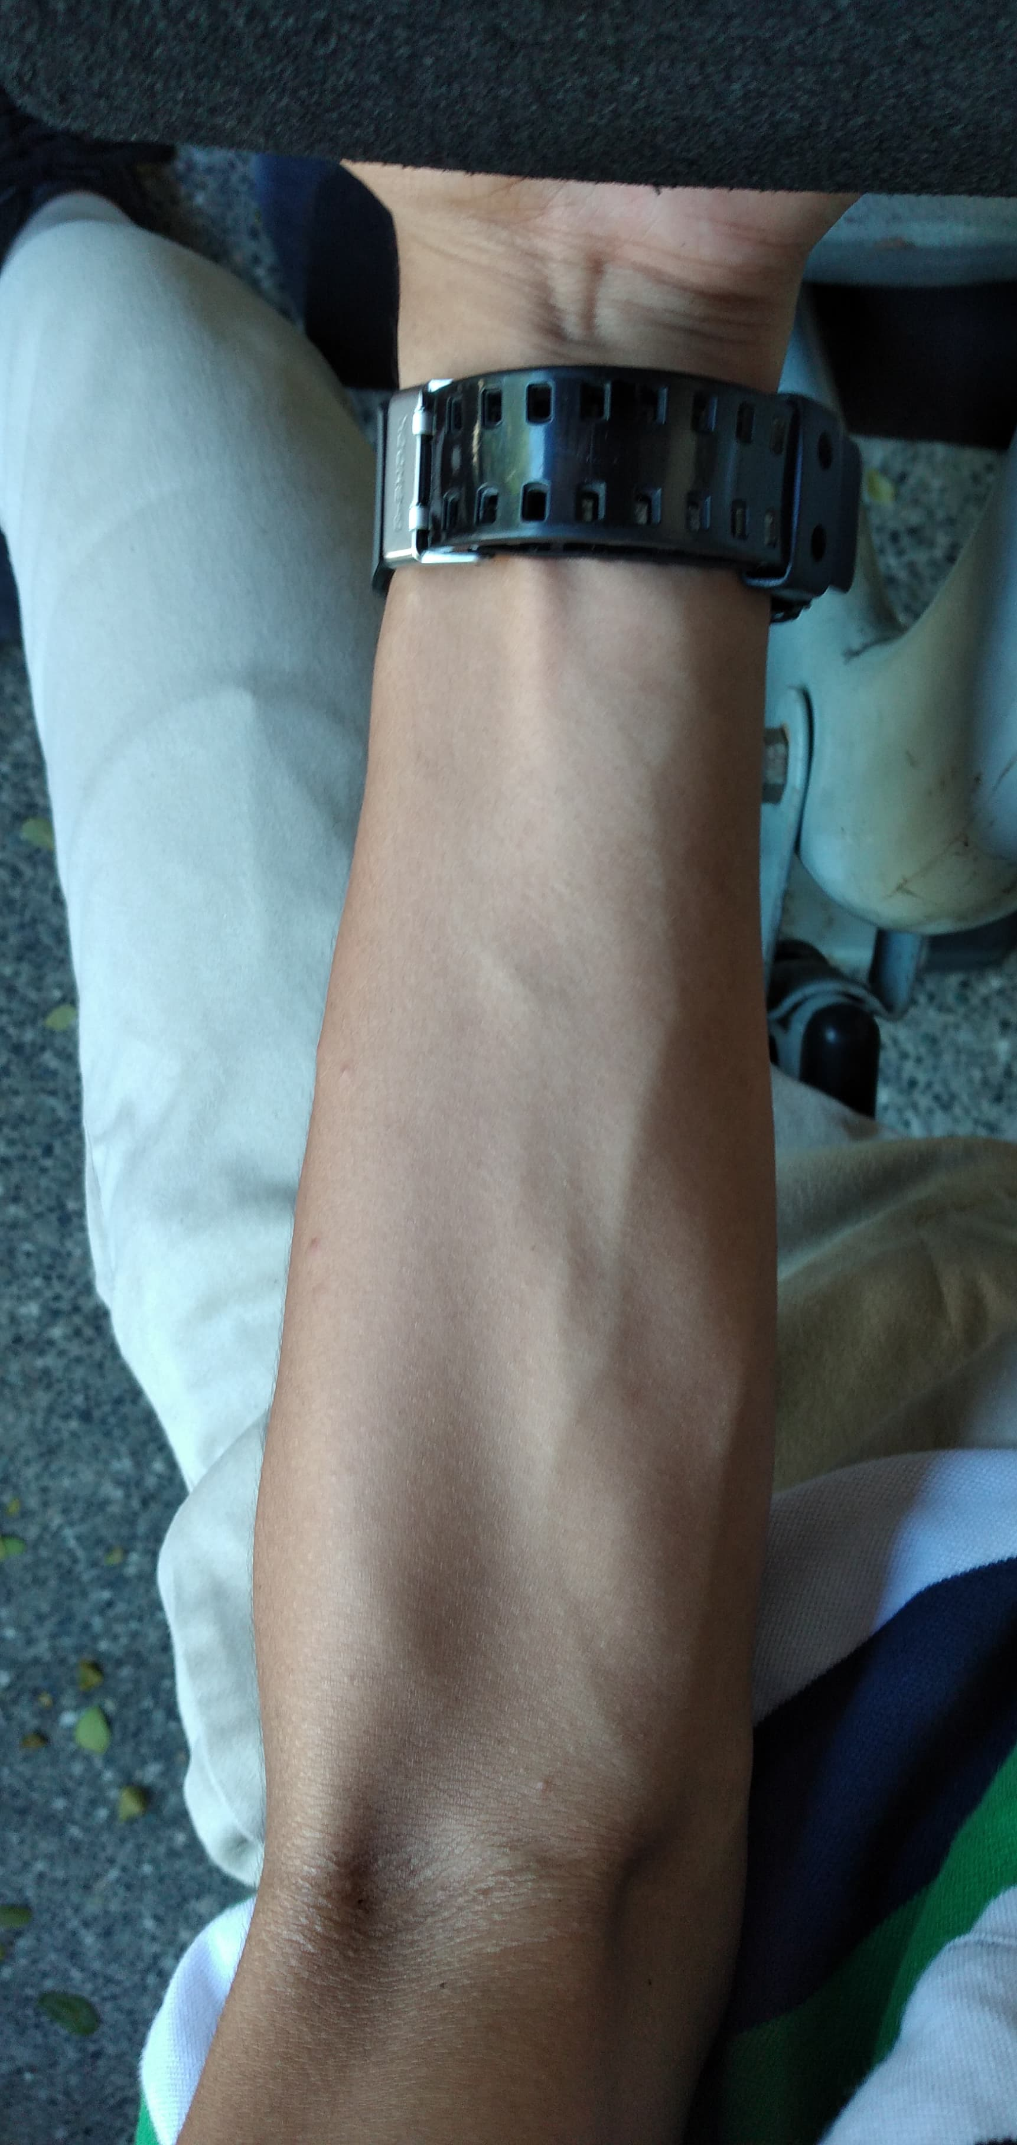
UGH YES

Slide 25
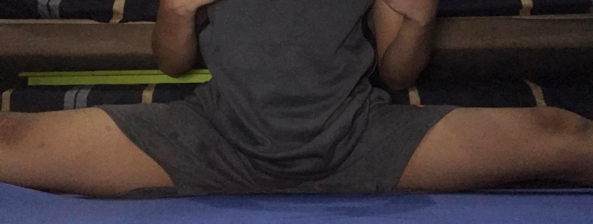
A picture is worth a thousand words
Syempre kakalimutan ko ba bayag mo

Slide 26
Sino ba si Val Allen?
Ito yung mga bagay na maddescribe ko sa’yo and mga na-realize ko habang nakikilala kita patagal nang patagal that makes me love you more!! ☺ <33333

Slide 27
a very good friend
Ang thoughtful mo and supportive sa friends mo hehehe and you are very dependable!! And honest and trustworthy and non-judgmental hehehehehe and many more ;)))))

Slide 28
Mabuting anak
Sobrang naappreciate mo parents mo and kitang-kita ko yung pagmamahal mo sa magulang mo I love you hehehe yung tipong handa kang malagay sa panganib para sa magulang mo ganon hahahahahaha basta anything na makakapagdescribe sa isang mabuting anak

Slide 29
Asawa ni malena tanga
Di ko na po kailangan iexplain hehe <33

Slide 30
Bakit ba kita mahal??????????????????
Acually nahirapan ako ditto kasi irdk yung certain reason kung bakit kita minahal pero sasabhin ko na lang yung mga dahilan kung baket mas lalo akong napapamahal sayo heheeheheheh

Slide 31
Pinapasaya mo ako ;)))))
Tho I know this sounds cliché but im so happy that you are mine. Youre the best person na kaya agad ako pasayahin even sa mga napakaliit na bagay ;(( and I will always be thankful for your existence

Slide 32
Nandiyan ka lang even at my lowest times
Lalo na kapag di mo ko iniiwan at tinutulugan hangga’t di ka sure na okay na ako. Thank you so much. I appreciate that ;((

Slide 33
You always care
Thank you for reminding me na ingatan sarili ko I love you and sa lahat ng tulong na nagawa mo for me :>>> na kahit minsan di ko narerealize na nabibigay mo thank you po so much hhehe

Slide 34
Sobrang patient mo ;((
Hindi mo ko iniiwan kahit anong mood ko ;( and kapag binibwisit kita hehehe naaalala ko po yung mukha niyong naiinis ka na pero nakangiti ka pa den so cute hahahahaha thank you po sa patience saken ;(( tho ang mainitin po ng ulo niyo minsan and nagagalet ka kagad saken sorry po

Slide 35
Willing to adjust sa tings tings
Hehehe napansin ko to sayo na willing ka lagi magadjust for us ;(( anddd you always try 2 get a little better each day ;(

Slide 36
You’re the best.
Idk di ko na siguro kailangan isa-isahin because to be honest you are more than I could have asked for ;(( You will always be my baby and only baby except sa anak naten heheh. I love you so much. <3

Slide 37
Maybe you need to divide the content
MERCURY
VENUS
Mercury is the closest planet to the Sun and the smallest one in the Solar System—it’s only a bit larger than our Moon. The planet’s name has nothing to do with the liquid metal since it was named after the Roman messenger god, Mercury
Venus has a beautiful name and is the second planet from the Sun. It’s terribly hot—even hotter than Mercury—and its atmosphere is extremely poisonous. It’s the second-brightest natural object in the night sky after the Moon

Slide 38
Thanks!
Sorry if halatang hapit huhuhuhuhuhuhuhuhuu mahal na mahal kita ;((((((((((

Slide 39
References
Puso at isip ni malena na punong-puno ng pagmamahal ng isang Val Eltagonde

